Slide 1



A Summary of 1076 - 2019 IEEE Standard VHDL Language Reference Manual
by Furkan Kaya, Koray Karakurt,
Mert Ecevit, Orhan Çalışkan, Seyit Koçak and Yunus Küçük
01/01/2025

Slide 2
3. Design entities & configurations
Chapter 3
Presenter:
Furkan Kaya
3.1 General
3.2 Entity Declarations
3.3 Architecture Bodies
3.4 Configuration Declarations

Slide 3
3.1 GENERAL
Examples 1 and 3 taken from "IEEE1076-2019" document where example 2 is my example.
Design Entity:
Entity declaration
Architecture bodies
Configuraiton decleration
3.2 ENTITY DECLARATIONS | 3.3 ARCHITECTURE BODIES | 3.4 CONFIGURATION DECLARATIONS
An entity in VHDL defines the external interface of a design.
An architecture in VHDL describes the internal implementation of an entity.
A configuration in VHDL specifies how components within an architecture are bound to entities and architectures.
entity full_adder is
port ( x, y, cin: in bit;
cout, sum: out bit
);
end full_adder;
entity andgate is
generic (
n: natural := 2
)
port(
inputs : in bit_vector (1 to n);
result : out bit
);
end entity andgate;
entity testbench is
end testbench;
architecture behavioral of sensor_cntrllr is
component i2c_master is
...
end component i2c_master;
constant por_lim : integer := 99_999;
type sensor_states is (
por_wait, cfg_sensor, take_data, bft_wait
);
signal sensor_ctrl_state : sensor_states;
signal por_cnt : integer range 0 to por_lim;
begin ...
library ttl, work;
configuration v4_27_87 of processor is
use work.all;
for structure_view
for a1: alu
use configuration ttl.sn74ls181;
end for;
for m1,m2,m3: mux
use entity multiplex4 (behavior);
end for;
for all: latch
-- use defaults
end for;
end for;
end configuration v4_27_87;
EX-1
EX-2
EX-3

Slide 4
4. Subprograms & packages
Chapter 4
Presenter:
Seyit Koçak
4.1 General
4.2 Subprogram Declarations
4.3 Subprogram Bodies
4.4 Subprogram Instantiation Declarations
4.5 Subprogram Overloading
4.6 Resolution Functions
4.7 Package Declarations
4.8 Package Bodies
4.9 Package Instantiation Declarations
4.10 Conformance Rules

Slide 5
4.1 GENERAL
Subprograms define algorithms through procedures and functions, serving to compute values or perform actions
Procedures are subprograms that execute a series of statements to perform actions but do not return a value, they are called as statements and can modify the state of the program
Functions are classified as pure or impure
Packages separate the declarations and bodies of these subprograms, allowing common resources to be shared
4.2 SUBPROGRAM DECLERATİONS
Subprogram declarations define procedures or functions by specifying their designator, parameters, generics (if any), and for functions, the return type and whether it is pure or impure
Procedures are always identified by a name, while functions can also be identified by operator symbols, enabling operator overloading
Functions return a value, whereas procedures execute actions without returning any value and can modify external variables or signals

Slide 6
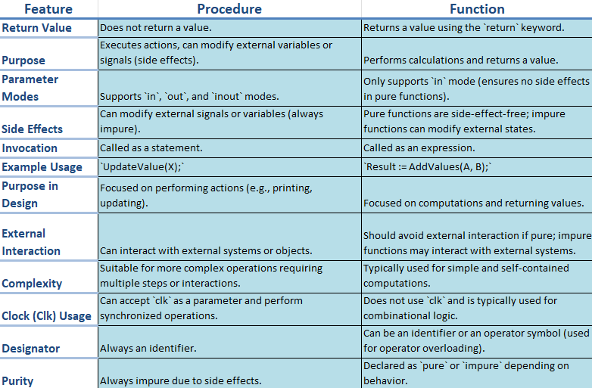
CODE EXAMPLE
library IEEE;
use IEEE.std_logic_1164.all;
use IEEE.numeric_std.all;
entity procedurewithclock is
port (
clk : in std_logic;
reset : in std_logic;
data_in : in std_logic_vector(7 downto 0);
data_out : out std_logic_vector(7 downto 0)
);
end procedurewithclock;
architecture behavioral of procedurewithclock is
procedure updatevalue(
signal clk : in std_logic;
signal reset : in std_logic;
signal data_in : in std_logic_vector(7 downto 0);
variable data_out : inout std_logic_vector(7 downto 0)
) is
begin
if reset = '1' then
data_out := (others => '0');
elsif rising_edge(clk) then
data_out := data_in;
end if;
end procedure;
begin
process(clk, reset)
variable temp_data : std_logic_vector(7 downto 0);
begin
updatevalue(clk, reset, data_in, temp_data);
data_out <= temp_data;
end process;
end behavioral;

Slide 7
4.2 SUBPROGRAM DECLARATİONS
Pure functions always return the same output for the same input values
Impure functions may produce different outputs for the same inputs or modify external variables or signals
Constant parameters allow read-only access, while variable parameters allow both reading and writing of values during subprogram execution
Signal parameters pass references to signals, their drivers, or both into the subprogram call
4.3 SUBPROGRAM BODIES
A body consists of three main parts: specification (definition of parameters and type), declarative part (variables, constants, or nested subprograms), and statement part (sequential operations)
4.4 SUBPROGRAM INSTANTIATION DECLARATIONS
Subprogram instantiation customizes a general subprogram template into an independent version with specific parameters or generics

Slide 8
CODE EXAMPLE
library IEEE;
use IEEE.std_logic_1164.all;
use IEEE.numeric_std.all;
package my_subprograms is
function add_integer(a, b: integer) return integer;
end my_subprograms;
package body my_subprograms is
function add_integer(a, b: integer) return integer is
begin
return a + b;
end add_integer;
end my_subprograms;
use work.my_subprograms.all;
entity subprogram_instantiation_example is
port (
a_in, b_in : in integer;
c_in, d_in : in integer;
result_int : out integer;
result_real: out integer
);
end subprogram_instantiation_example;
architecture behavioral of subprogram_instantiation_example is
constant threshold : integer := 10;
begin
process(a_in, b_in, c_in, d_in)
variable temp_result_int : integer; --temporary storage
variable temp_result_real : integer;
begin
if (a_in > threshold and b_in > threshold) then
temp_result_int := add_integer(a_in, b_in);
result_int <= temp_result_int;
else
result_int <= 0;
end if;
if (c_in > threshold and d_in > threshold) then
temp_result_real := add_integer(c_in, d_in);
result_real <= temp_result_real;
else
result_real <= 0;
end if;
end process;
end behavioral;

Slide 9
4.7,8,9 PACKAGE DECLARATIONS,BODIES,INSTANTIATION
CODE EXAMPLE
Package declarations define the interface of a package, including constants, types, subprograms, and generics
Items declared in a package can be made visible in other design units through selection or use clauses
A package body must match its corresponding package declaration and follow it in the same declarative region
Package instantiation declarations create an instance of an uninstantiated package, associating actuals with generics through a generic map aspect
library IEEE;
use IEEE.std_logic_1164.all;
package mypackage is
constant default_value: integer := 10;
function double(value: integer) return integer;
function triple(value: integer) return integer;
end package mypackage;
package body mypackage is
function double(value: integer) return integer is
begin
return value * 2;
end function double;
function triple(value: integer) return integer is
begin
return value * 3;
end function triple;
end package body mypackage;
entity packageexample is
port (
inputvalue : in integer;
outputvalue : out integer;
triplevalue : out integer
);
end packageexample;
architecture behavioral of packageexample is
use work.mypackage.all;
begin
process(inputvalue)
begin
outputvalue <= double(inputvalue);
triplevalue <= triple(inputvalue);
end process;
end behavioral;

Slide 10
5. tYPES
Chapter 5
Presenter:
Seyit Koçak
5.1 General
5.2 Scalar Types
5.3 Composite Types
5.4 Access Types
5.5 File Types
5.6 Protected Types
5.7 String Representations
5.8 Unspecified Types

Slide 11
5.1 GENERAL
A type is defined by a set of values and operations, including basic and predefined operations automatically provided
Composite types can be unconstrained, fully constrained, or partially constrained
Types are divided into five main categories: scalar, composite, access, file, and protected types
5.2 SCALAR TYPES
scalar_type_definition ::=
enumeration_type_definition
| integer_type_definition
| floating_type_definition
| physical_type_definition;
TYPE word_index IS RANGE 31 DOWNTO 0;
TYPE my_real IS RANGE 0.0 TO 9.99;
TYPE distance IS RANGE 0 TO 1E16
UNITS
-- Basiseinheit :
A -- Angström
-- Metrische Einheiten :
nm = 10 A; -- Nanometer
um = 1000 nm; -- Mikrometer
mm = 1000 um; -- Millimeter
cm = 10 mm; -- Centimeter
m = 1000 mm; -- Meter
km = 1000 m; -- Kilometer
END UNITS;

Slide 12
CODE EXAMPLES
process(sw)
variable value_int : integer;
begin
value_int := to_integer(unsigned(sw));
thousands <= std_logic_vector(to_unsigned(value_int / 1000, 4));
hundreds <= std_logic_vector(to_unsigned((value_int / 100) mod 10, 4));
tens <= std_logic_vector(to_unsigned((value_int / 10) mod 10, 4));
ones <= std_logic_vector(to_unsigned(value_int mod 10, 4));
end process;
process(current_digit, ones, tens, hundreds, thousands)
begin
case current_digit is
when ones_digit => an <= "1110"; seg <= binary_to_seven_segment(ones);
when tens_digit => an <= "1101"; seg <= binary_to_seven_segment(tens);
when hundreds_digit => an <= "1011"; seg <= binary_to_seven_segment(hundreds);
when thousands_digit => an <= "0111"; seg <= binary_to_seven_segment(thousands);
when others => an <= "1111"; seg <= (others => '1');
end case;
end process;
process(slow_clk)
begin
if rising_edge(slow_clk) then
case current_digit is
when ones_digit => current_digit <= tens_digit;
when tens_digit => current_digit <= hundreds_digit;
when hundreds_digit => current_digit <= thousands_digit;
when thousands_digit => current_digit <= ones_digit;
when others => current_digit <= ones_digit;
end case;
end if;
end process;
end behavioral;
library IEEE;
use IEEE.std_logic_1164.all;
use IEEE.numeric_std.all;
entity bcdtoseven is
port (
sw : in std_logic_vector(13 downto 0);
clk : in std_logic;
seg : out std_logic_vector(6 downto 0);
an : out std_logic_vector(3 downto 0)
);
end bcdtoseven;
architecture behavioral of bcdtoseven is
type digit_type is (ones_digit, tens_digit, hundreds_digit, thousands_digit);
signal current_digit : digit_type := ones_digit;
signal ones, tens, hundreds, thousands : std_logic_vector(3 downto 0);
signal slow_clk : std_logic := '0';
signal clk_divider : integer := 0;
type binary_value_type is (
ZERO, ONE, TWO, THREE, FOUR, FIVE,
SIX, SEVEN, EIGHT, NINE );
function binary_to_seven_segment(input : std_logic_vector(3 downto 0)) return std_logic_vector is
variable seg_output : std_logic_vector(6 downto 0);
begin
case input is
when ZERO => seg_output := "1000000";
when ONE => seg_output := "1111001";
when TWO => seg_output := "0100100";
when THREE => seg_output := "0110000";
when FOUR => seg_output := "0011001";
when FIVE => seg_output := "0010010";
when SIX => seg_output := "0000010";
when SEVEN => seg_output := "1111000";
when EIGHT => seg_output := "0000000";
when NINE => seg_output := "0010000";
when others => seg_output := "1111111";
end case;
return seg_output;
end function;
begin
process(clk)
begin
if rising_edge(clk) then
if clk_divider = 50000 then
slow_clk <= not slow_clk;
clk_divider <= 0;
else
clk_divider <= clk_divider + 1;
end if;
end if;
end process;

Slide 13
5.3 COMPOSITE TYPES
composite_type_definition ::=
array_type_definition |
record_type_definition
VHDL arrays store multiple elements of the same type in an organized way and provide fast access
Arrays are used for grouping data, modeling multidimensional structures, and performing operations on large data sets
They serve as a foundation for creating dynamic data structures and algorithms, enabling efficient data management and simulation
Record types in VHDL allow grouping of different types of elements under a single name, where each element can have a different data type
Record types are useful for modeling complex data structures where multiple related values need to be stored together, such as a set of properties for an object

Slide 14
5.4 ACCSESS TYPES
Access type provides a way to point to objects
Access type allows dynamically creating objects in memory
The DEALLOCATE procedure releases allocated memory
type Int_Ptr is access Integer;
variable Ptr : Int_Ptr := null; -- Initially points to nothing
-------------------------------------------------------------------------
Ptr := new Integer(5); -- Creates an integer object in memory with a value of 5
-------------------------------------------------------------------------
DEALLOCATE(Ptr); -- Frees the memory and sets Ptr to null
5.5 FILE TYPES
In VHDL, file types are used to define objects that represent files in the system, and the data within the file is constrained by a specific subtype
A file can be managed with operations like READ, WRITE, SEEK, and FLUSH, where the reading and writing modes determine the type of operation

Slide 15
5.6 PROTECTED TYPES
CODE EXAMPLES
When to Use Protected Types?
When concurrent data access occurs (multiple processes need to access the same data simultaneously)
When the secure management of shared resources is required
When control and organization are necessary for data manipulation
When restricted access to critical sections is needed to ensure consistency and avoid race conditions
library IEEE;
use IEEE.std_logic_1164.all;
use IEEE.numeric_std.all;
use work.sharedcounter.all;
entity protectedtypes is
port (
clk : in std_logic;
out_counter : out integer
);
end protectedtypes;
architecture behavior of protectedtypes is
shared variable counter: sharedcounter;
begin
process(clk)
begin
if rising_edge(clk) then
counter.increment;
end if;
end process;
process(clk)
begin
if rising_edge(clk) then
out_counter <= counter.getvalue;
end if;
end process;
end behavior;
library IEEE;
use IEEE.std_logic_1164.all;
use IEEE.numeric_std.all;
protected type sharedcounter is
procedure increment;
function getvalue return integer;
end protected;
protected body sharedcounter is
variable count: integer := 0;
procedure increment is
begin
count := count + 1;
end procedure;
function getvalue return integer is
begin
return count;
end function;
end protected body;

Slide 16
5.7 STRING REPRESENTATIONS
Why is String Representations under the types section?
Strings are a VHDL type: Defined as arrays of characters, part of the type hierarchy
Ensures type safety: Fixed or constrained strings prevent design errors
Essential for testing: Key for assertions, debugging, and messages
5.8 UNSPECIFIED TYPES
Unspecified types allow abstract type definitions in VHDL
They are used for generics, ports, and parameters
Types are determined during elaboration
They support scalar, array, access, and file types
These types enable flexible and reusable designs

Slide 17
6. DECLARATIONS
Chapter 6
Presenter:
Mert Ecevit
6.1 General
6.2 Type Declarations
6.3 Subtype Declarations
6.4 Objects
6.5 Interface Declarations
6.6 Alias Declarations
6.7 Attribute Declarations
6.8 Component Declarations
6.9 Group Template Declarations
6.10 Group Declarations
6.11 PSL Clock Declarations

Slide 18
6.2 Type Declarations
Custom structures and types for more accurate data representation are made possible by type declarations, which establish new data types in VHDL
6.3 Subtype Declarations
A type together with a constraint
6.4 Objects
In VHDL, an object is a container for a value of a given type
6.5 Interface Declarations
• Interface declarations define interface objects of a precisely defined type
• Interface objects are interface constants, interface signals, interface variables and interface files
6.6 Alias Declarations
An alias is an alternative name for an existing object (signal, variable or constant)
They don’t define a new object

Slide 19
6.7 Attribute Declarations
Attributes are user-defined properties attached to types, signals, entities, etc.
They can store metadata or control simulation aspects
6.8 Component Declarations
Components act as templates for modules or logic blocks that can be instantiated multiple times in a design which allows reusability and modular design
6.9 Group Template Declarations
A group declaration declares a group, a named collection of named entities
6.10 Group Declarations
• A group template declaration declares a group template, which defines the allowable classes of named entities that can appear in a group
.
6.11 PSL Clock Declarations
When doing formal verification, module’s properties have to expresses using the Property Specification Language (PSL)

Slide 20
Code Example
library IEEE;
use IEEE.std_logic_1164.all;
--type and subtype declarations package custom is
type boolean is (false, true);
type bit_vector is array (7 downto 0) of bit; --type declarations subtype my_vector is std_logic_vector (3 downto 0);
subtype word is unsigned(15 downto 0); --subtype declarations
end package custom;
entity example is
port (
clk : in std_logic;
reset : in std_logic;
result : out std_logic
);
end example;
architecture bhv of example is
-- Constant declaration
constant loop_number : integer := 7;
-- Signal declarations
signal sum, carry1, carry2 : bit := '0';
-- Variable declaration (used in a process)
signal carry : std_logic := '0';
for i in 0 to loop_number loop
if i mod 2 = 0 then
carry <= '1';
temp_result := carry;
else
carry <= '0';
temp_result := carry;
end if;
end loop;
sum <= '1';
carry1 <= bit(carry);
carry2 <= '1';
result <= temp_result;
end if;
end process;
end bhv;
begin
process(clk, reset)
variable temp_result : std_logic := '0';
begin
if reset = '1' then
sum <= '0';
carry1 <= '0';
carry2 <= '0';
carry <= '0';
temp_result := '0';
result <= '0';
elsif rising_edge(clk) then

Slide 21
Code Examples
--Interface Declaration
type axi4_lite_write_address_type is record
aw_addr : std_logic_vector ;
aw_prot : std_logic_vector ;
aw_valid : std_logic ;
aw_ready : std_logic ;
end record axi4_lite_write_address_type ;
--encapsulation
view axi4_lite_write_address_master_view of axi4_lite_write_address_type is
aw_addr : out ;
aw_prot : out ;
aw_valid : out ;
aw_ready : in ;
end view axi4_lite_write_address_master_view of ;
-- a view declaration for the mode replacement
axi_master1 : view axi4_lite_master_view ;
axi_master2 : view axi4_lite_master_view of axi4_lite_type ;
axi_responder1 : view axi4_lite_responder_view ;
axi_responder2 : view axi4_lite_responder_view ;
--Use the interface in an entity declaration
library IEEE;
use IEEE.STD_LOGIC_1164.ALL;
entity timing_example is
port (
clk : in std_logic;
reset : in std_logic;
signal_in : in std_logic;
signal_out : out std_logic
);
end timing_example;
architecture behavioral of timing_example is
-- Constant declaration
constant tc : time := 2.5 ns;
-- Alias declaration
alias delay : time is tc;
begin
process(clk, reset)
begin
if reset = '1' then
signal_out <= '0' after delay;
elsif rising_edge(clk) then
signal_out <= signal_in after delay;
end if;
end process;
end behavioral;

Slide 22
Code Examples
--Attribute Declaration
library IEEE;
use IEEE.std_logic_1164.all;
package my_types is
type t is (a, b, c, d, e);
subtype s is t range d downto b;
end package my_types;
entity attribute_example is
port (
input_a : in std_logic_vector(7 downto 0);
input_b : in std_logic_vector(7 downto 0);
result : out std_logic_vector(15 downto 0)
);
end attribute_example;
architecture behavioral of Attribute_Example is
use work.my_types.all;
signal signal_a : std_logic_vector(7 downto 0);
signal signal_b : std_logic_vector(7 downto 0);
signal product : std_logic_vector(15 downto 0);
signal my_enum : s := d;
begin
process
begin
signal_a <= input_a;
signal_a <= input_b;
product <= std_logic_vector(unsigned(signal_a) * unsigned(signal_b));
product(product'left) <= '1';
wait;
end process;
end behavioral;
--Component Declaration
library IEEE;
use IEEE.std_logic_1164.all;
entity component_instantiation is
port (add1, add2: in integer;
sum_1: out integer);
end;
architecture example of component_instantiation is
component adder is
port (a, b: in integer;
sum: out integer);
end component;
begin
component_inst: adder_component
port map (a => add1
b => add2,
sum => sum);
end example;
--Group Declaration
architecture rtl of Ent is
group operations is (signal <>);
group adders: operations (x, y, z);
begin
a1: x <= a + b;
a2: y <= c + d;
a3: z <= e + f;
end architecture rtl;

Slide 23
7. Specifications
Chapter 7
Presenter:
Furkan Kaya
7.1 General
7.2 Attribute specification
7.3 Configuration specification
7.4 Disconnection specification

Slide 24
7.1 GENERAL
Specifications in VHDL, which define additional properties or configurations for design elements, increasing clarity, control, and customization in hardware modeling.
7.2 ATTRIBUTE
SPECIFICATION
7.3 CONFIGURATION
SPECIFICATION
7.4 DISCONNECTION
SPECIFICATION
Associate attributes with VHDL objects to define additional properties or behaviors.
Define how components are bound to specific entities or architectures within a design.
Define conditions under which resolved signals can be disconnected during simulation.
attribute pin_no of cin: signal is 10;
attribute pin_no of cout: signal is 5;
attribute location of adder1: label is (10,15);
attribute location of others: label is (25,77);
attribute capaticance of all: signal is 15 pf;
attribute implementation of g1: group is "74ls152";
attribute rising_delay of c2q: group is 7.2 ns;
use work.global_signals.all;
configuration different of half_adder is
for structure
for l1: xor_gate
generic map (2.9 ns, 3.6 ns);
end for;
for l2: and_gate
generic map (2.8 ns, 3.25 ns)
port map (i2 => tied_high);
end for;
end for;
end configuration different;
disconnect s: t after 10 ns;
disconnect others: t after 5 ms;
disconnect all: t after 273 us;
10 ns, 5 ms and 273 us are
just arbitrary time expressions.
EX-1
EX-2
EX-3
All of the examples are taken from "IEEE1076-2019" document

Slide 25
8. NAMES
Chapter 8
Presenter:
Orhan Çalışkan
8.1 General
8.2 Simple Names
8.3 Selected Names
8.4 Indexed Names
8.5 Slice Names
8.6 Attribute Names
8.7 External Names

Slide 26
8.1 GENERAL
Names can include :
Simple Name (represents a single entity)
Operator Symbol (represent operators)
Character Literal (represent a single character) (not in VHDL2002)
Selected Name (provide access to an element from a package or record)
Indexed Name (access to a specific element of an array or vector)
Slice Name (represent a specific range of an array or vector)
Attribute Name (represent an Attribute)
External Name (represent an external entity) (not in VHDL2002)
8.2 SIMPLE NAMES
Simple names is the name you directly give to an object (signal, variable, entity, architecture, function, procedure, package etc.)

Slide 27
8.3 SELECTED NAMES
Selected names access an object from within another object or from a library
Provide modularity and readability
Include prefix and suffix
Selected_name ::= prefix.suffix
IEEE.std_logic_1164.all
8.4 INDEXED NAMES
Indexed names used in VHDL to access specific elements of arrays.
One index for each dimension
Indexes must be within the bounds of the array
indexed_name ::= prefix ( expression { , expression } )

Slide 28
8.5 SLICE NAMES
Slice name represents a segment of consecutive elements from an array
Follows the format prefix(discrete_range)
data(15 downto 0) -- A slice with a descending range
data(0 to 15) -- A slice with a ascending range
data(0 downto 15) -- A null slice
8.6 ATTRIBUTE NAMES
Attribute name represents a value, function, type, range, signal, or constant associated with an entity
follows the format : prefix [signature] 'attribute_designator [ (expression) ]
clk'delayed(5 ns) -- clk signal delayed by 5 ns

Slide 29
8.7 EXTERNAL NAMES
External name denotes an object declared in the design hierarchy containing the external name
External Variable Name: Provides access to variables defined in other regions
External Signal Name: Provides access to signals defined in other regions
External Constant Name: Allows access to constants from external regions
Package Pathname: Provides access to a specific element within a package. It is used to access elements defined within a specific package in the design
Absolute Pathname: Starts from the root of the design and encompasses the entire hierarchy. It provides access to elements at the highest level of the design
Relative Pathname: Accesses an element by moving up or down from the current location. It provides dynamic access based on the current position
Partial Pathname: Refers to a specific element in more detail. It points to a particular part of the design

Slide 30
CODE EXAMPLE
library IEEE;
use IEEE.std_logic_1164.all; --This line is example for selected name
use work.example_package.all; --This line is example for external name
Entity my_design is --my_design is a simple name
port
(
clk : in std_logic;
rst : in std_logic;
input_vld : in std_logic;
comm_input : in std_logic_vector (15 downto 0); --comm_input port is a slice name
output_vld : in std_logic;
data_out : out std_logic_vector(15 downto 0) --data_out port is a slice name
);
end my_design;
architecture behavioral of my_design is
signal data : std_logic_vector(data_upper_lmt downto data_lower_lmt); --data is a static name
begin
process(clk) begin
if (clk'event and clk = '1') then --clk'event is a attribute name
if(input_vld = '1') then
data <= comm_input(15 downto 1) & not comm_input(0);
--comm_input(0) is a indexed name
end if;
if(output_vld = '1') then
data_out <= data;
end if;
end if;
end process;

Slide 31
9. EXPRESSIONS
Chapter 9
Presenter:
Mert Ecevit
9.1 General
9.2 Operators
9.3 Operands
9.4 Static Expressions
9.5 Universal Expressions

Slide 32
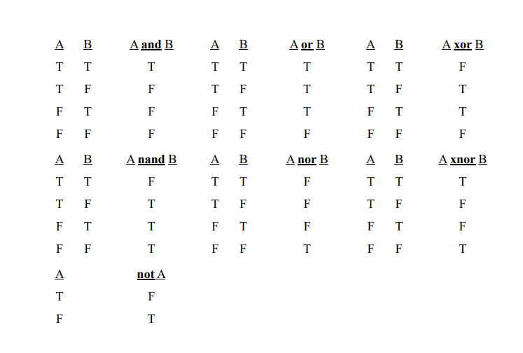
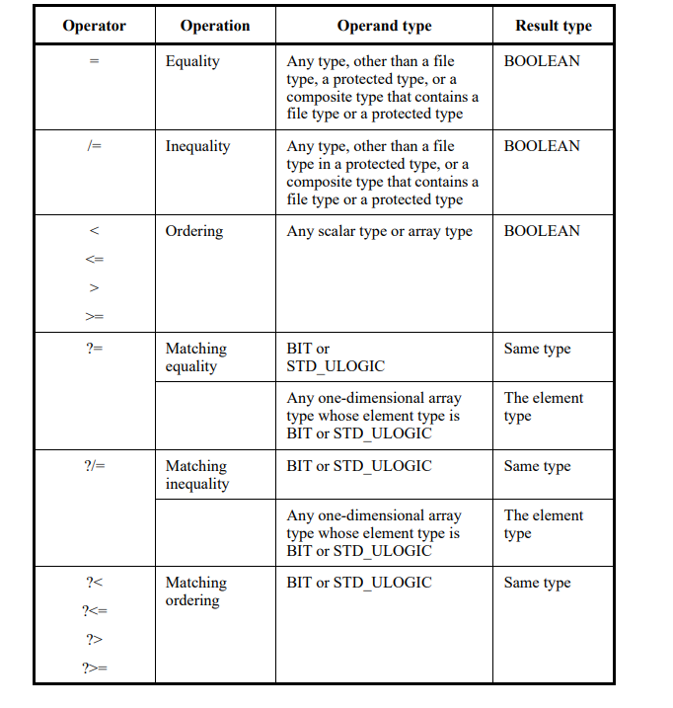
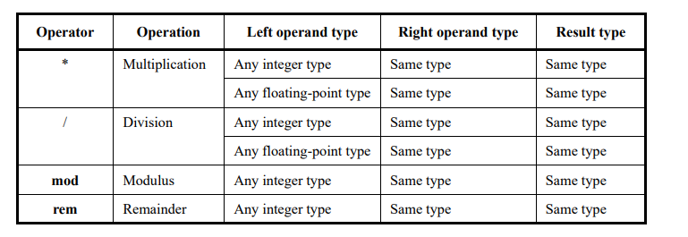
9.2 Operators
A formula that defines the computation of a value.

Slide 33
9.3 Operands
The operands in an expression includes literals, aggregates, function, calls, type conversions
9.4 Static Expressions
• Utilized in constant declarations or restrictions; fully computed at compile time
• There are two categories of static expression: – If every operator in expression is an implicit defined operator, these are called locally static expressions – If every in the expression is a pure function and every primary in the expression is a global static primary, they are called globally static expressions
9.5 Universal Expressions
• A universal expression is either an expression that delivers a result of type universal integer or one that delivers a result of type universal real
• The same operations are predefined for the type universal integer as for any integer type
• The same operations are predefined for the type universal real as for any floating-point type
• In addition, these operations include the multiplication and division operators

Slide 34
10. SEQUENTIAL STATEMENTS
Chapter 10
Presenter:
Yunus Küçük
10.1 General
10.2 Wait Statement
10.3 Assertion Statement
10.4 Report Statement
10.5 Signal Assignment Statement
10.6 Variable Assignment Statement
10.7 Procedure Call Statement
10.8 If Statement
10.9 Case Statement
10.10 Loop Statement
10.11 Next Statement
10.12 Exit Statement
10.13 Return Statement
10.14 Null Statement
10.15 Sequential Block Statement

Slide 35
10.1 General
Sequential statements are used to define algorithms for the execution of a subprogram or process; they execute in the order in which they appear

Slide 36
10.2 WaIt Statement
There are 4 different types of wait statements which are:
wait: it will suspend code forever
wait on: is equivalent to using a sensitivity list in a process. As soon as any of the signals in the wait on list changes, the code will continue to execute
wait until: it will suspend a process until the condition of the wait is true
Wait for: is never synthesizable. However, it is still very useful for test benches and for bus functional models. Wait for must be followed by some amount of time, for example 10 ns
One additional note: A process that has a sensitivity list can not contain any wait statements

Slide 37
10.3 Assertıon statement
Checks that a specified condition is true and reports an error if it is not
Syntax:
[ label: ] assert condition [ report string_expression ] [ severity expression ];
Description:
The assertion statement has three optional fields and usually all three are used
The condition specified in an assertion statement must evaluate to a Boolean value (true or false). If it is false, it is said that an assertion violation occurred
The expression specified in the report clause must be of predefined type String and is a message to be reported when assertion violation occurred
If the severity clause is present, it must specify an expression of predefined type Severity_Level, which determines the severity level of the assertion violation
The Severity_Level type is specified in the Standard package and contains the following values: Note, Warning, Error, and Failure
If the severity clause is omitted it is implicitly assumed to be Error.
assert not (Reset = '0' and Set = '0') report "set-reset conflict" severity Failure;
assert result = ExpectedResults report "results differ from expected results" severity Warning;
Notes:
The message is displayed when the condition is false, therefore the message should be an opposite to the condition
The concurrent assertion statement is a passive process and as such can be specified in an entity
The concurrent assertion statement monitors the specified condition continuously.
Synthesis tools generally ignore assertion statements
CODE EXAMPLE

Slide 38
10.4 report statement
A statement that displays a message
Syntax:
[ label: ] report string_expression [ severity expression ];
Description:
The main difference between the report statement and the assertion statement is that the message in the report statement is displayed unconditionally
If the severity clause is present, it must specify an expression of predefined type Severity_Level, which has the values: Note, Warning, Error, and Failure
report "End of simulation" severity note;
Notes:
If the severity clause is omitted in a report statement it is implicitly assumed to be Note
If the severity clause is used then the default is Error
CODE EXAMPLE

Slide 39
CODE EXAMPLE of waıt statements
entity T07_WaitOnUntilTb is
end entity;
architecture sim of T07_WaitOnUntilTb is
signal CountUp : integer := 0;
signal CountDown : integer := 10;
begin
process is
begin
CountUp <= CountUp + 1;
CountDown <= CountDown - 1;
wait for 10 ns;
end process;
process is
begin
wait on CountUp, CountDown;
report "CountUp=" & integer'image(CountUp) &
" CountDown=" & integer'image(CountDown);
end process;
process is
begin
wait until CountUp = CountDown;
report "Jackpot!";
end process;
end architecture;

Slide 40
Note: CountUp=1 CountDown=9
Time: 0 ps Iteration: 1 Process: /T07_WaitOnUntilTb/line__20 File: D:/Projects/Deneme1/Deneme1.srcs/sources_1/new/deneme.vhd
Note: CountUp=2 CountDown=8
Time: 10 ns Iteration: 1 Process: /T07_WaitOnUntilTb/line__20 File: D:/Projects/Deneme1/Deneme1.srcs/sources_1/new/deneme.vhd
Note: CountUp=3 CountDown=7
Time: 20 ns Iteration: 1 Process: /T07_WaitOnUntilTb/line__20 File: D:/Projects/Deneme1/Deneme1.srcs/sources_1/new/deneme.vhd
Note: CountUp=4 CountDown=6
Time: 30 ns Iteration: 1 Process: /T07_WaitOnUntilTb/line__20 File: D:/Projects/Deneme1/Deneme1.srcs/sources_1/new/deneme.vhd
Note: CountUp=5 CountDown=5
Time: 40 ns Iteration: 1 Process: /T07_WaitOnUntilTb/line__20 File: D:/Projects/Deneme1/Deneme1.srcs/sources_1/new/deneme.vhd
Note: Jackpot!
Time: 40 ns Iteration: 1 Process: /T07_WaitOnUntilTb/line__29 File: D:/Projects/Deneme1/Deneme1.srcs/sources_1/new/deneme.vhd
Note: CountUp=6 CountDown=4
Time: 50 ns Iteration: 1 Process: /T07_WaitOnUntilTb/line__20 File: D:/Projects/Deneme1/Deneme1.srcs/sources_1/new/deneme.vhd

Slide 41
10.5 SIGNAL ASSIGNMENT statement
Description:
Modifies the projected output waveforms contained in the drivers of one or more signals
Schedules a force for one or more signals or schedules release of one or more signals
Syntax:
signal_assignment_statement ::=
[ label : ] simple_signal_assignment |
[ label : ] conditional_signal_assignment |
[ label : ] selected_signal_assignment
CODE EXAMPLE
-- Assignments using inertial delay:
-- The following three assignments are equivalent to each other:
Output_pin <= Input_pin after 10 ns;
Output_pin <= inertial Input_pin after 10 ns;
Output_pin <= reject 10 ns inertial Input_pin after 10 ns;
-- Assignments with a pulse rejection limit less than the time
-- expression:
Output_pin <= reject 5 ns inertial Input_pin after 10 ns;
Output_pin <= reject 5 ns inertial Input_pin after 10 ns,
not Input_pin after 20 ns;
--Conditional signal assignment
target <= delay_mechanism
waveform1 when condition1 else
waveform2 when condition2 else
···
···
waveformN-1 when conditionN-1 else
waveformN when conditionN

Slide 42
10.6 varıable ASSIGNMENT statement
Description:
The purpose of variables in VHDL is in cases where you need to drive outputs of a process by something that will change throughout the process, and you need to capture each of those changes
Notes:
Variables can only be used inside processes
Any variable that is created in one process cannot be used in another process
Variables need to be defined after the keyword process but before the keyword begin
Variables are assigned using the := assignment symbol
Variables that are assigned immediately take the value of the assignment
The most important thing to understand is that variables immediately take the value of their assignment

Slide 43
CODE EXAMPLE
Note: MyVariable=1, MySignal=0
Note: MyVariable=2, MySignal=1
Note: MyVariable=3, MySignal=2
Note: MyVariable=4, MySignal=3
Note: MyVariable=5, MySignal=4
Note: MyVariable=6, MySignal=5
Note: MyVariable=7, MySignal=6
Note: MyVariable=8, MySignal=7
Note: MyVariable=9, MySignal=8
.
.
.
library ieee;
use ieee.std_logic_1164.all;
use ieee.numeric_std.all;
entity Variable_Statement is
end entity;
architecture sim of Variable_Statement is
signal MySignal : integer := 0;
begin
process
variable MyVariable : integer := 0;
begin
MyVariable := MyVariable + 1;
MySignal <= MySignal + 1;
report "MyVariable=" & integer'image(MyVariable) &
", MySignal=" & integer'image(MySignal);
wait for 10ns;
end process;
end architecture;

Slide 44
10.7 procedure CALL statement
Description:
A procedure is a type of subprogram in VHDL which can help us avoid repeating code
Sometimes the need arises to perform identical operations several places throughout the design
While creating a module might be overkill for minor operations, a procedure is often what you want
Procedures can be declared within any declarative region
The scope of the procedure will be limited to wherever it’s declared, architecture, package, or process
Whenever you call the procedure, it will behave like the code of the procedure was inserted where it was called from
A procedure’s parameter list defines its inputs and outputs, kind of like a mini-module
It can be a signal or a constant, but unlike a module, it can also be a variable
You can declare objects between the “is” and “begin” keywords that are only valid inside the procedure
These may include constants, variables, types, subtypes, and aliases, but not signals
Syntax:
procedure <procedure_name>
(signal|variable|constant <name1> : in|out|inout <type>;
signal|variable|constant <name2> : in|out|inout <type>;
... ) is
<declarations_for_use_within_the_procedure>
begin
<code_performed_by_the_procedure_here>
end procedure;

Slide 45
10.8 ıf statement
Description:
Selects for execution one or none of the enclosed sequences of statements, depending on the value of one or more corresponding conditions
Syntax:
if_label : if condition then
sequence_of_statements
elsif condition then
sequence_of_statements
else
sequence_of_statements
end if;

Slide 46
CODE EXAMPLE
entity If_Statement is
end entity;
architecture sim of If_Statement is
signal CountUp : integer := 0;
signal CountDown : integer := 10;
begin
process is
begin
CountUp <= CountUp + 1;
CountDown <= CountDown - 1;
wait for 10 ns;
end process;
process is
begin
if CountUp > CountDown then
report "CountUp is larger";
elsif CountUp < CountDown then
report "CountDown is larger";
else
report "They are equal";
end if;
wait on CountUp, CountDown;
end process;
end architecture;
Note: CountDown is larger
Time: 0 ps Iteration: 0
Note: CountDown is larger
Time: 0 ps Iteration: 1
Note: CountDown is larger
Time: 10 ns Iteration: 1
Note: CountDown is larger
Time: 20 ns Iteration: 1
Note: CountDown is larger
Time: 30 ns Iteration: 1
Note: They are equal
Time: 40 ns Iteration: 1
Note: CountUp is larger
Time: 50 ns Iteration: 1
Note: CountUp is larger
Time: 60 ns Iteration: 1
Note: CountUp is larger
Time: 70 ns Iteration: 1
Note: CountUp is larger
Time: 80 ns Iteration: 1
Note: CountUp is larger
Time: 90 ns Iteration: 1
Note: CountUp is larger
Time: 100 ns Iteration: 1
Note: CountUp is larger

Slide 47
10.9 case statement
Syntax:
case <expression> is
when <choice> =>
code for this branch
when <choice> =>
code for this branch
...
end case;
Description:
Works exactly the way that a switch statement in C works
Given an input, the statement looks at each possible condition to find one that the input signal satisfies
Useful to check one input signal against many combinations
Just like in C, the VHDL designer should always specify a default condition provided that none of the case statements are chosen
This is done via the “when others =>” statement (check the code example in the next page)

Slide 48

library ieee;
use ieee.std_logic_1164.all;
use ieee.numeric_std.all;
entity Case_Statementis
end entity;
architecture sim of Case_Statementis
signal Sig1 : unsigned(7 downto 0) := x"AA";
signal Sig2 : unsigned(7 downto 0) := x"BB";
signal Sig3 : unsigned(7 downto 0) := x"CC";
signal Sig4 : unsigned(7 downto 0) := x"DD";
signal Sel : unsigned(1 downto 0) := (others => '0');
signal Output1 : unsigned(7 downto 0);
begin
-- Stimuli for the selector signal
process is
begin
wait for 10 ns;
Sel <= Sel + 1;
wait for 10 ns;
Sel <= Sel + 1;
wait for 10 ns;
Sel <= Sel + 1;
wait for 10 ns;
Sel <= Sel + 1;
wait for 10 ns;
Sel <= "UU";
wait;
end process;
-- Equivalent MUX using a case statement
process(Sel, Sig1, Sig2, Sig3, Sig4) is
begin
case Sel is
when "00" =>
Output2 <= Sig1;
when "01" =>
Output2 <= Sig2;
when "10" =>
Output2 <= Sig3;
when "11" =>
Output2 <= Sig4;
when others => -- 'U', 'X', '-', etc.
Output2 <= (others => ‘0');
end case;
end process;
end architecture;
CODE EXAMPLE

Slide 49
10.10 loop statement
Syntax:
for <name> in <lower_limit> to <upper_limit> loop
<statement>;
<statement>;
end loop;
while <condition> loop
<statement>;
<statement>;
end loop;

Slide 50
CODE EXAMPLE
library ieee;
use ieee.std_logic_1164.all;
use ieee.std_logic_unsigned.all;
use ieee.numeric_std.all;
entity Loop_Statement is
end entity;
architecture sim of Loop_Statement is
begin
for_process : process is
begin
for i in 1 to 10 loop
report "i = " & integer'image(i);
end loop;
wait;
end process;
while_process : process is
variable j : integer := 0;
begin
while j < 10 loop
report "j = " & integer'image(j);
j := j + 2;
end loop;
wait;
end process;
end architecture;

Slide 51
10.11 next statement
Completes execution of one of the iterations of an enclosing loop statement, making it jump back to the top of that loop
The completion is conditional if the statement includes a condition
Syntax:
[ label: ] next [ loop_label ] [ when condition ];
Description:
The next statement allows to skip a part of an iteration loop
If the condition specified after the when reserved word is true, or if there is no condition at all, then the statement is executed
This results in skipping all statements below it until the end of the loop and passing the control to the first statement in the next iteration
A next statement may specify the name of the loop it is expected to influence. If no label is supported then the statement applies to the innermost enclosing loop.
Note:
Often confused with the exit statement
The difference is that the exit statement "exits" the loop entirely, while the next statement skips to the "next" loop iteration
CODE EXAMPLE
L1: loop
k:= 0;
L2: for CountValue in 1 to 8 loop
next when CountValue = N; -- jump to next itteration of loop L2
if A(k):= 'U' then
next L1; -- jump to top of loop L1
end if;
k:= k + 1;
end loop L2;
end loop L1;

Slide 52
10.12 Exıt statement
Finishes or exits the execution of an enclosing loop statement
Syntax:
[ label: ] exit [ loop_label ] [ when condition ];
Description:
Terminates entirely the execution of the loop in which it is located
If a condition is placed on the exit statement, then the execution of the exit statement depends on the condition placed at the end of the statement
When the condition is true (or if there is no condition at all) the exit statement is executed, and the control is passed to the first statement after the end loop
L1: loop
L2: for I in 0 to 7 loop
if B(I) = 'U' then
exit L1;
end if;
exit when I = M;
end loop L2;
...
end loop L1;
Note: The exit statement is often confused with the next statement, the difference between the two is that the exit statement "exits" the loop entirely, while the next statement skips to the "next" loop iteration (in other words, "exits" only the current iteration of the loop)
CODE EXAMPLE

Slide 53
10.13 Return statement
Completes the execution of the innermost enclosing function or procedure body
Syntax:
[ label: ] return [ expression ];
Description :
Ends the execution of a subprogram (procedure or function) in which it appears
Causes an unconditional jump to the end of the subprogram
Only allowed in a procedure or function body
In a procedure it may not return any value, while a return in a function must return a value consistent with the return type of the function
return X + Y;
CODE EXAMPLE

Slide 54
10.14 null statement
A null statement performs no action
Syntax:
[ label : ] null ;
Description:
The execution of the null statement has no effect other than to pass on to the next statement

Slide 55
10.15 SEQUENTIAL BLOCK statement
Encloses a sequence of sequential statements
Could be nested
Syntax:
sequential_block_statement ::=
[ sequential_block_label : ] block [ is ]
sequential_block_declarative_part
begin
sequential_block_statement_part
end [ block ] [ sequential_block_label ] ;
sequential_block_declarative_part ::=
{ process_declarative_item }
sequential_block_statement_part ::=
{ sequential_statement }
Description:
The execution of a sequential block statement consists of the elaboration of the sequential block declarative part followed by the execution of the statements in the sequential block statement part
If a label appears at the end of a sequential block statement, it shall repeat the sequential block label
It is an error if a variable declaration in a process declarative part declares a shared variable

Slide 56
11. Concurrent statements
Chapter 11
Presenter:
Mert Ecevit
11.1 General
11.2 Block Statement
11.3 Process Statement
11.4 Concurrent Procedure Call Statements
11.5 Concurrent Assertion Statments
11.6 Concurrent Signal Assignment Statements
11.7 Component Instantiation Statements
11.8 Generate Statements

Slide 57
11.2 Block Statement
A block statement defines an internal block representing a portion of a design
11.3 Process Statement
Processes the signals associated with architecture
11.4 Concurrent Procedure Call Statements
Procedures can also be used like a concurrent statement, when it is called from a concurrent code region
11.5 Concurrent Assertion Statements
A concurrent assertion statement represents a passive process statement containing the specified assertion statement

Slide 58
11.6 Concurrent Assertion Statements
A concurrent assertion statement represents a passive process statement containing the specified assertion statement.
11.7 Component Instantiation Statements
Component instantiation allows you to instantiate one design unit (component) inside another design unit to create a hierarchically structured design description.
11.8 Generate Statements
Generate statements are used to accomplish one of two goals:
– Replicating Logic in VHDL
– Turning on/off blocks of logic in VHDL

Slide 59
CODE EXAMPLES
-Block Statement
architecture rtl of dsp is
...
begin
mac_unit: block
port (a, b: in float32; mac_out: out float32);
port map (a = > x, b = > y, mac_out = > acc);
signal multiplier_out: float32;
signal adder_out: float32 ;
begin
multiplier_out <= a * b;
adder_out <= multiplier_out + mac_out;
process (clock, reset) begin
if reset then
mac_out <= ( others = > '0');
elsif rising_edge(clock) then
mac_out <= adder_out;
end if ;
end process ;
end block ;
...
end architecture rtl;
--Process statement
library IEEE;
use IEEE.std_logic_1164.all;
use IEEE.numeric_std.all;
entity D_FF is
port( d,clk: in std_logic;
q: out std_logic);
end D_FF;
architecture bhv of D_FF is
begin
process(clk)
begin
if rising_edge(clk) then
Q <= D;
end if;
end process;
end bhv;
--Concurrent Signal Assignment
library IEEE;
use IEEE.IEEE.std_logic_1164.all;
entity add_1 is
port ( a, b, cin: in bit;
s, cout: out bit);
end add_1;
architecture concurrent of add_1 is
signal s1, s2, s3, s4: bit;
begin
s1 <= b xor cin;
s2 <= a and b;
s3 <= a and cin;
s4 <= b and cin;
s <= a xor s1;
cout <= s2 or s3 or s4;
end concurrent;

Slide 60
CODE EXAMPLES
--Concurrent Procedure Call Statement
library IEEE;
use IEEE.std_logic_1164.all;
use IEEE.numeric_std.all;
entity adder is
port (a, b: in integer;
sum: out integer);
end adder;
architecture behavior of adder is
begin
sum <= a + b;
end;
architecture bhv of adder is
procedure add(a, b: in integer;
signal sum: out integer) is begin
sum <= a + b;
end;
begin
adder_component : adder port map (add1, add2, sum1);
adder_procedure : add(add1, add2, sum2),
end architecture bhv;
--equivalent statements
architecture sensitiviy_list of adder is
begin
process(add1, add2)
begin
add(add1, add2, sum2);
end process;
end architecture; --sensitivity list
architecture wait_statement of adder is
begin
process
begin
add(add1, add2, sum2);
wait on add1, add2;
end process;
end wait_statement; --wait statement
--Concurrent Assertion Statement
library IEEE;
use IEEE.IEEE.std_logic_1164.all;
use IEEE._std_logic_arith.all;
use IEEE.std_logic_unsigned.all;
entity tb_address_check is
end tb_address_check;
architecture behavior of tb_address_check is
signal address : STD_LOGIC_VECTOR(31 downto 0);
component address_check
Port ( address : in STD_LOGIC_VECTOR(31 downto 0));
end component;
begin
uut: address_check Port map (address => address);
stim_proc: process
begin
address <= x"0000_1234"; wait for 10 ns;
address <= x"9000_1234"; wait for 10 ns;
address <= x"4000_0000"; wait for 10 ns;
address <= x"1000_0000"; wait for 10 ns;
wait;
end process;
-- Concurrent assertion
assert (to_integer(unsigned(address)) < x"1000_0000" or to_integer(unsigned(address)) >= x"8000_0000")
report "Invalid access at address " & to_string(address)
severity warning;
end behavior;

Slide 61
CODE EXAMPLES
--Component Instantiation
library IEEE;
use IEEE.std_logic_1164.all;
entity component_instantiation is
port (add1, add2: in integer;
sum_1: out integer);
end;
architecture example of component_instantiation is
component adder is
port (a, b: in integer;
sum: out integer);
end component;
begin
component_inst: adder_component
port map (a => add1
b => add2,
sum => sum);
end example;
--Entity Instantiation and Generate Statement
entity full_adder1 is
Port (a : in std_logic;
b : in std_logic;
carry_in : in std_logic;
sum : out std_logic;
carry_out: out std_logic);
end full_adder1;
--full code
library IEEE;
use IEEE.IEEE.std_logic_1164.all;
use IEEE._std_logic_arith.all;
use IEEE.std_logic_unsigned.all;
architecture structural of adder is
signal carry_in_vector: std_logic_vector( 0 to WIDTH- 1);
signal carry_out_vector: std_logic_vector( 0 to WIDTH- 1);
begin
instantiate_adders: for i in 0 to WIDTH- 1 generate --generate statement and entity instantiation
adder_bit: entity work.full_adder1
port map (a = > a(i), b = > b(i), carry_in = > carry_in_vector(i),
sum = > sum(i), carry_out = > carry_out_vector(i));
end generate ;
carry_in_vector <= (carry_in, carry_out_vector( 0 to WIDTH- 2));
carry_out <= carry_out_vector(WIDTH- 1);
end structural;

Slide 62
12. Scope and vısıbılıty
Chapter 12
Presenter:
Orhan Çalışkan
12.1 Declerative Region
12.2 Scope of Decleration
12.3 Visibility
12.4 Use Clauses
12.5 The Context of Overload Resolution

Slide 63
12.1 DECLERATIVE REGION
Declarative region in VHDL is a text area where declarations and definitions are valid
Entity and its associated architecture body
Subprograms (procedures/functions) and their bodies
Packages and their bodies (if any)
Process, block, loop, and generate statement
Declarations belong to the innermost region where they are defined
Structures like the architecture body are not affected by the scope outside their own region
Root Declarative Region: The top-level region of each design
Library Declarative Region: Defined for each design library, encompassing all units within the library
library ieee;
use ieee.std_logic_1164.all;
entity myentity is
-- entity declarative region
...
end myentity;
architecture behavioral of myentity is
-- architecture declarative region
begin
process(...)
-- process declarative region
begin
end process;
end behavioral;

Slide 64
12.2 SCOPE OF DECLERATIONS
The portion of code where a declaration or named entity is valid
Scope defines the usage area of the declaration or entity
Scope starts from the declaration and extends to the end of the innermost declarative region
The scope of an architecture body is limited to its internal region
Structures like package, record type, subprogram parameters, generics and ports extend their scope to the enclosing unit
Architecture body is included in the scope of its associated Entity
Block configurations and Library declarations can extend the scope
PSL verification units can be linked to extend the scope into verification structures.

Slide 65
12.3 VISIBILITY
Visibility determines the area where elements of a declaration are valid. A declaration can only be used within its visible scope
Multiple declarations with the same name can be made, and the visibility rules determine which declaration is valid
Component configuration and block configuration declarations can become visible by selection
Use clauses modify the visibility of declarations. Hiding conceals the same-named declarations from the outer scope
An identifier cannot be used at the beginning of a declaration; it is valid only after the declaration end
constant k: integer := k*k; -- illegal constant t: t; -- illegal
procedure P (X: P); -- illegal
function Q (X: real := Q) return 0; -- illegal
procedure R (R: real); -- legal (although perhaps confusing)

Slide 66
12.4 USE CLAUSES
Use Clause makes declarations in a package or library directly visible
Using all makes all declarations visible
Declarations can be hidden by homographs
In case of explicit and implicit homographs, only the explicit one is visible
Declarations in uninstantiated packages cannot be made visible
use IEEE.std_logic_1164.all
use work.my_package.all
use work.my_package.my_function

Slide 67
12.5 THE CONTEXT OF OVERLOAD RESOLUTION
Overloading is when the same name or operator refers to different entities in different contexts
Overload Resolution is the process used to select the correct meaning when multiple meanings are possible
RULES
Compatibility between names, expressions, and types
Conformance between parameters and types
Selecting the correct entity based on the context

Slide 68
13. DESIGN UNITS AND THEIR ANALYSIS
Chapter 13
Presenter:
Orhan Çalışkan
13.1 Design Units
13.2 Design Libraries
13.3 Context Declerations
13.4 Context Clauses
13.5 Order of Analysis

Slide 69
13.1 DESIGN UNITS
Independently analyzed constructs that are added to the design library
Design file consists of multiple design units
Primary Units: Core structures like entity declarations, package declarations, and context declarations
Secondary Units: Bodies of primary units, such as architecture bodies
13.2 DESIGN LIBRARIES
Design Library: An implementation-dependent storage area for design units. An application can support multiple design libraries
Library Clause: Defines logical names for libraries in design units. If the same name is defined multiple times, only the first definition is valid.
Working Library: The library where the library unit resulting from the analysis of a design unit is place
Resource Library: Libraries that contain library units referenced in the analyzed design unit

Slide 70
13.3,4 CONTEXT DECLERATIONS / CONTEXT CLAUSE
Context Declaration: Defines context items that design units can reference
Context Clause: Defines the initial name environment before the analysis of a design unit
Scope: library_clause, use_clause, context_reference
Library Clause: Defines the logical library names to be used in the design unit
Use Clause: Makes certain declarations directly visible within the design unit
Context Reference: References another context declaration
context project_context is
library project_lib;
use project_lib.project_defs.all;
library IP_lib;
context IP_lib.IP_context;
end context project_context;

Slide 71
13.5 ORDER OF ANALYSIS
The order of design unit analysis is based on visibility rules
A primary unit must be analyzed before the design unit where its name is referenced
A primary unit must be analyzed before its corresponding secondary unit, as the secondary unit depends on the primary unit
In case of an error, the analysis is rejected and does not affect the working library
A changed library unit may affect other units that reference its name
A changed library unit becomes obsolete and must be reanalyzed before it can be used again

Slide 72
14. ELABORATION AND EXECUTION
Chapter 14
Presenter:
Seyit Koçak
14.1 General
14.2 Elaboration of a Design Hierarchy
14.3 Elaboration of a Block, Package, Subprogram or Protected Type Header
14.4 Elaboration of a Declarative Part
14.5 Elaboration of a Statement Part
14.6 Dynamic Elaboration
14.7 Execution of a Model

Slide 73
14.1 GENERAL
To execute a model, the design hierarchy is first elaborated, followed by the initialization of nets, and then the repetitive simulation cycle begins, during which processes are executed and nets are updated
14.2 ELABORATION OF A DESIGN HIERARCHY
Definition: Creates processes interconnected by nets, enabling simulation
Process:
Executes vhpiCbStartOfElaboration and vhpiCbEndOfElaboration callbacks.Prepares block statements and implicit configurations for unbound components
Key Steps:
Elaborates packages sequentially to resolve dependencies
Configures PSL verification units after block elaboration
Creates drivers and initializes scalar signals

Slide 74
14.3 ELABORATION OF a BLOCK, PACKAGE, SUBPROGRAMS OR PROTECTED TYPE HEADER
Describes the preparation of protected types, generics, subprograms, and ports, including their mapping and association. This ensures all components are properly initialized and ready for simulation
14.4 ELABORATION OF A DECLARATIVE PART
Type definitions, subtypes, subprograms, and protected types are elaborated sequentially
. Attribute, configuration, and disconnection specifications are processed
Binding information, default values, and signal associations are properly established
14.5 ELABORATION OF A STATEMENT PART
Purpose:
Ensure concurrent statements are correctly prepared for simulation
Concurrent Statements:
All concurrent statements in a block are elaborated sequentially
Generate Statements:
For-Generate: Creates blocks for each value in a specified range
If-Generate: Creates a block if the condition evaluates to true; otherwise, no block is created
Case-Generate: Creates a block for the matching alternative based on an evaluated expression
Component Instantiation: If bound to a design entity, the corresponding block is elaborated

Slide 75
14.6 DYNAMIC ELABORATION
Definition:
Dynamic elaboration occurs during simulation execution for constructs with sequential statements
Key Instances:
Loop Statements: Loop parameters are elaborated, and the range is evaluated before execution
Subprogram Calls: Parameters are elaborated and checked; exclusive access is required for protected or file operations
Allocators: Subtype elaboration occurs before object allocation
Sequential Blocks: Declarative parts are elaborated before block execution
14.7 EXECUTION OF A MODEL
Drivers: Handle signal value changes via transactions
Signal Updates: Compute and apply driving and effective values
Implicit Signals: Update signals like S'STABLE and S'QUIET per kernel rules

Slide 76
13. Lexıcal elements
Chapter 15
Presenter:
Orhan Çalışkan
15.1 General
15.2 Character Set
15.3 Lexical Elements, Separators and Delimiters
15.4 Identifiers
15.5 Abstract Literals
15.6 Character Literals
15.7 String Literals
15.8 Bit String Literals
15.9 Comments
15.10 Reserved Words
15.11 Tools Directives

Slide 77
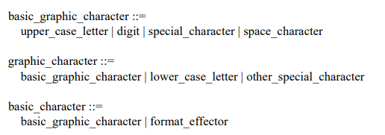
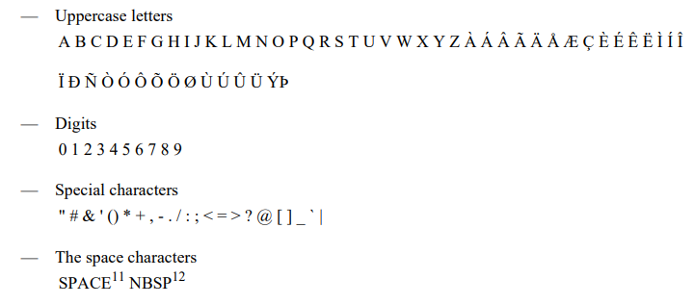
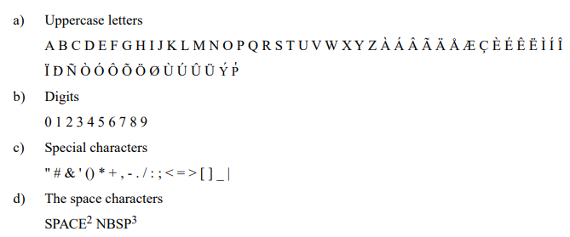
15.1,2 GENERAL / CHARACTER SET
VHDL2019
VHDL2002

Slide 78
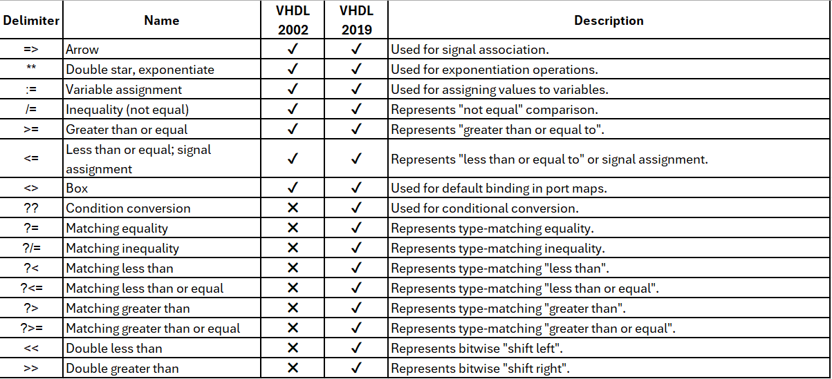
15.3 LEXICAL ELEMENTS, SEPARATORS AND DELIMITERS
Lexical Elements
Identifiers
Literals
Delimiters and Separators
Comments
Separators
Space
End of Line
Format Effectors
Delimiters
Special Characters

Slide 79
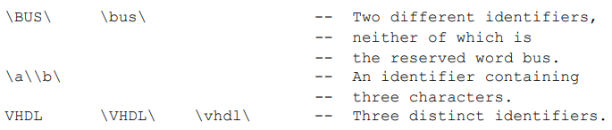
15.4 IDENTIFIERS
Basic identifiers are names used in VHDL to label objects
Letters (A-Z, a-z)
Digits (0-9)
Underscore (_)
Valid Examples : clk_100, my_signal1, raw_data, rst_n
Invalid Examples : 100_clk, my-signal1, _rawdata
Extended identifiers in VHDL are names that can include any graphic character
Letters (A-Z, a-z)
Digits (0-9)
Special Characters (#, =, -, _ etc.)
Space Characters
Extended identifiers are case sensitive
Extended identifiers must be wrap the backslashes(\)

Slide 80
15.5,6,7,8 LITERALS
Abstract Literals: Represent values in basic numerical types.
Decimal Literals: Express numerical values (integer or fractional)
Based Literals: Specify numerical values in a specific base (binary, octal, hexadecimal).
Bit String Literals: Define numerical systems with specific bit sequences (B, O, X)
Character Literals: Represent a single character
String Literals: Represent a sequence of characters
signal bit_signal : bit := ‘0’ ; -- Bit Literal
signal bit_vector : bit_vector(7 downto 0) := x "128 " ; --Based Literals
signal real_signal_pi : real := 3.14 ; -- Real Literal
signal string_signal : string := "VHDL" ; -- String Literal
signal another_char_signal : character := ‘1’ ; -- Character Literal

Slide 81
15.9 COMMENTS
port
(
clk : in std_logic ;
rst : in std_logic
input_vld : in std_logic ;
comm_input : in std_logic_vector (15 downto 0); --comm_input port is a slice name
output_vld : in std_logic ;
data_out : out std_logic_vector(15 downto 0) --data_out port is a slice name
);

Slide 82
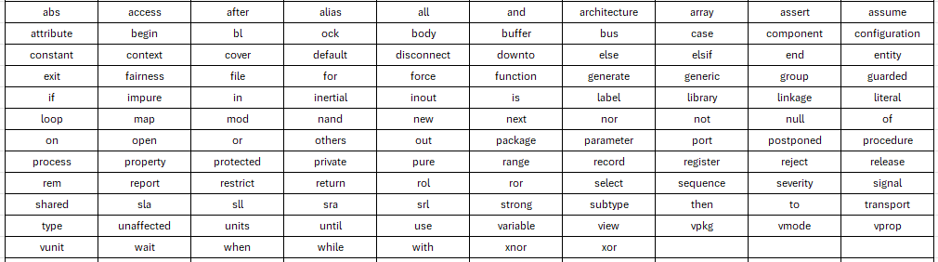
15.10 RESERVED WORDS
15.11 TOOL DIRECTIVE
In VHDL, a tool directive is a command that directs a tool to perform a specific operation
It starts with a backtick (`) and extends to the end of the line
`define my_macro

Slide 83
Chapter 16
Presenter:
Mert Ecevit
16. Predefıned language envıronment
16.1 General
16.2 Predefined Attributes
16.3 Package STANDARD
16.4 Package TEXTIO
16.5 Standard Environment Package
16.6 Standard Mathematical Packages
16.7 Standard Multivalue Logic Package
16.8 Standard Synthesis Packages
16.9 Standard Synthesis Context Declarations
16.10 Fixed-point Package
16.11 Floating Point Package
16.12 Reflection Package

Slide 84
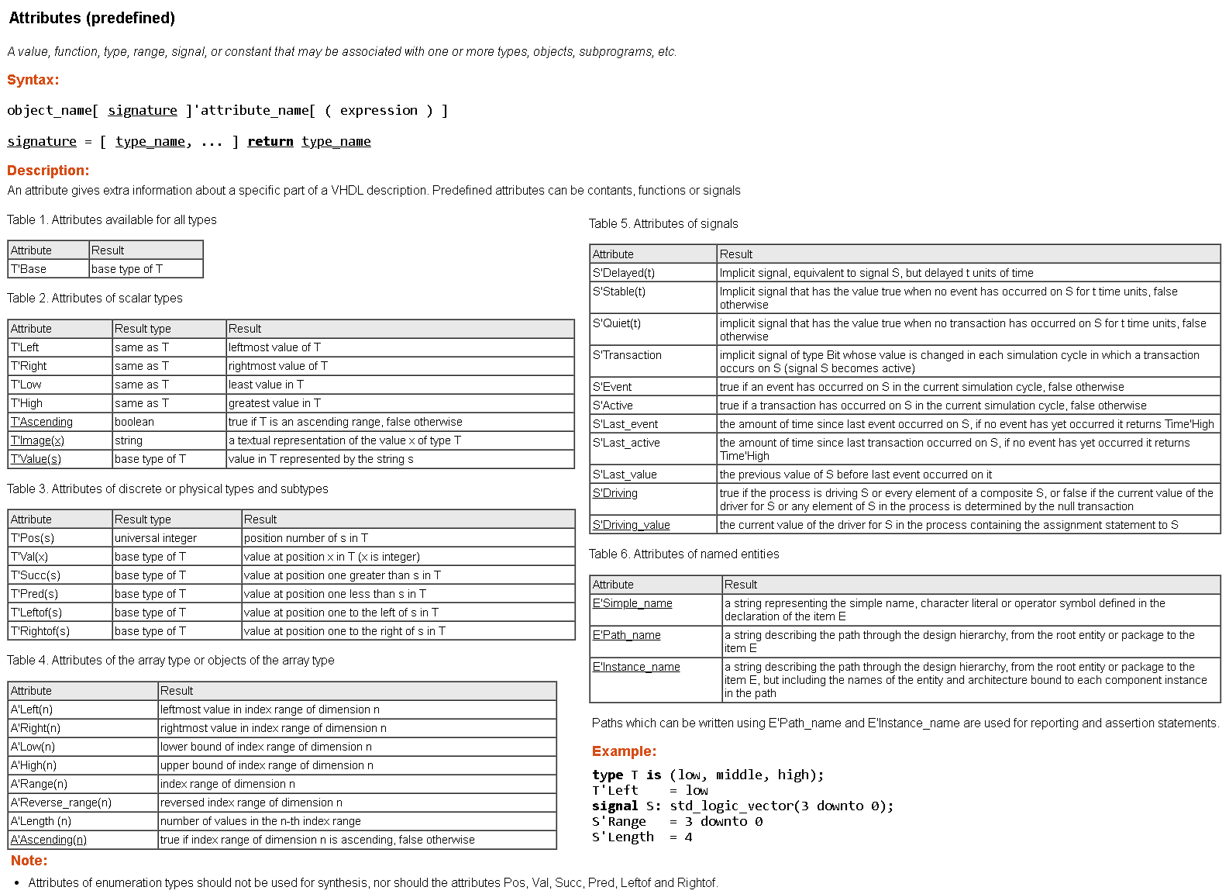
16.2 Predefined Attributes
https://www.hdlworks.com/hdl_corner/vhdl_ref/VHDLContents/AttributesPredefined.htm

Slide 85
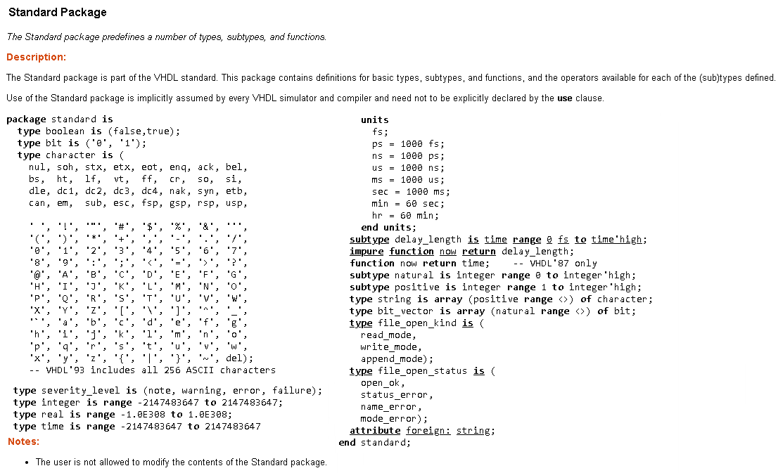
16.3 Package STANDARD
https://www.hdlworks.com/hdl_corner/vhdl_ref/VHDLContents/StandardPackage.htm

Slide 86
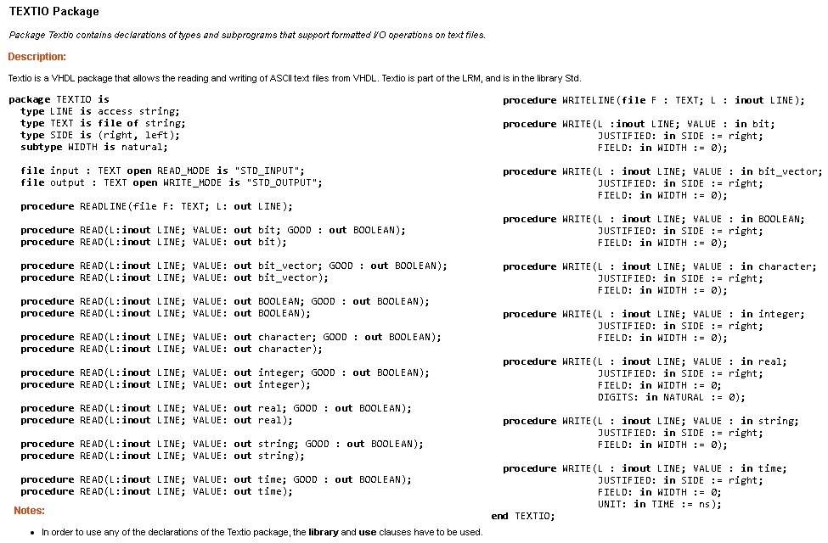
16.4 Package TEXTIO
https://www.hdlworks.com/hdl_corner/vhdl_ref/VHDLContents/TEXTIOPackage.htm

Slide 87
16.5 Standard Environment Package
The standard environmental package (ENV), which was introduced in VHDL-2008, has been extended with subprograms for reading and writing in directories on the native filesystem.
This package allows VHDL code to control the simulator, and to find out the simulator time resolution.
procedure stop(status:integer);
procedure stop;
procedure finish(status:integer);
procedure finish;
function resolution_limit return delay_length;
wait for env.resolution_limit;

Slide 88
16.6 Standard Mathematical Packages
library IEEE;
Package MATH_REAL is
constant MATH_E : real := 2.71828_18284_59045_23536;
constant MATH_1_E: real := 0.36787_94411_71442_32160;
constant MATH_PI : real := 3.14159_26535_89793_23846;
constant MATH_1_PI : real := 0.31830_98861_83790_67154;
constant MATH_LOG_OF_2: real := 0.69314_71805_59945_30942;
constant MATH_LOG_OF_10: real := 2.30258_50929_94045_68402;
constant MATH_LOG2_OF_E: real := 1.44269_50408_88963_4074;
constant MATH_LOG10_OF_E: real := 0.43429_44819_03251_82765;
constant MATH_SQRT2: real := 1.41421_35623_73095_04880;
constant MATH_SQRT1_2: real := 0.70710_67811_86547_52440;
constant MATH_SQRT_PI: real := 1.77245_38509_05516_02730;
constant MATH_DEG_TO_RAD: real := 0.01745_32925_19943_29577;
constant MATH_RAD_TO_DEG: real := 57.29577_95130_82320_87685;
attribute FOREIGN : string;
function SIGN (X: real ) return real;
function CEIL (X : real ) return real;
function FLOOR (X : real ) return real;
function ROUND (X : real ) return real;
function FMAX (X, Y : real ) return real;
function FMIN (X, Y : real ) return real;
procedure UNIFORM (variable Seed1,Seed2:inout integer; variable X:out real);
function SQRT (X : real ) return real;
function CBRT (X : real ) return real;
function "**" (X : integer; Y : real) return real;
function "**" (X : real; Y : real) return real;
function EXP (X : real ) return real;
function LOG (X : real ) return real;
function LOG (BASE: positive; X : real) return real;
function SIN (X : real ) return real;
function COS ( X : real ) return real;
function TAN (X : real ) return real;
function ASIN (X : real ) return real;
function ACOS (X : real ) return real;
function ATAN (X : real) return real;
function ATAN2 (X : real; Y : real) return real;
function SINH (X : real) return real;
function COSH (X : real) return real;
function TANH (X : real) return real;
function ASINH (X : real) return real;
function ACOSH (X : real) return real;
function ATANH (X : real) return real;
end MATH_REAL;

Slide 89
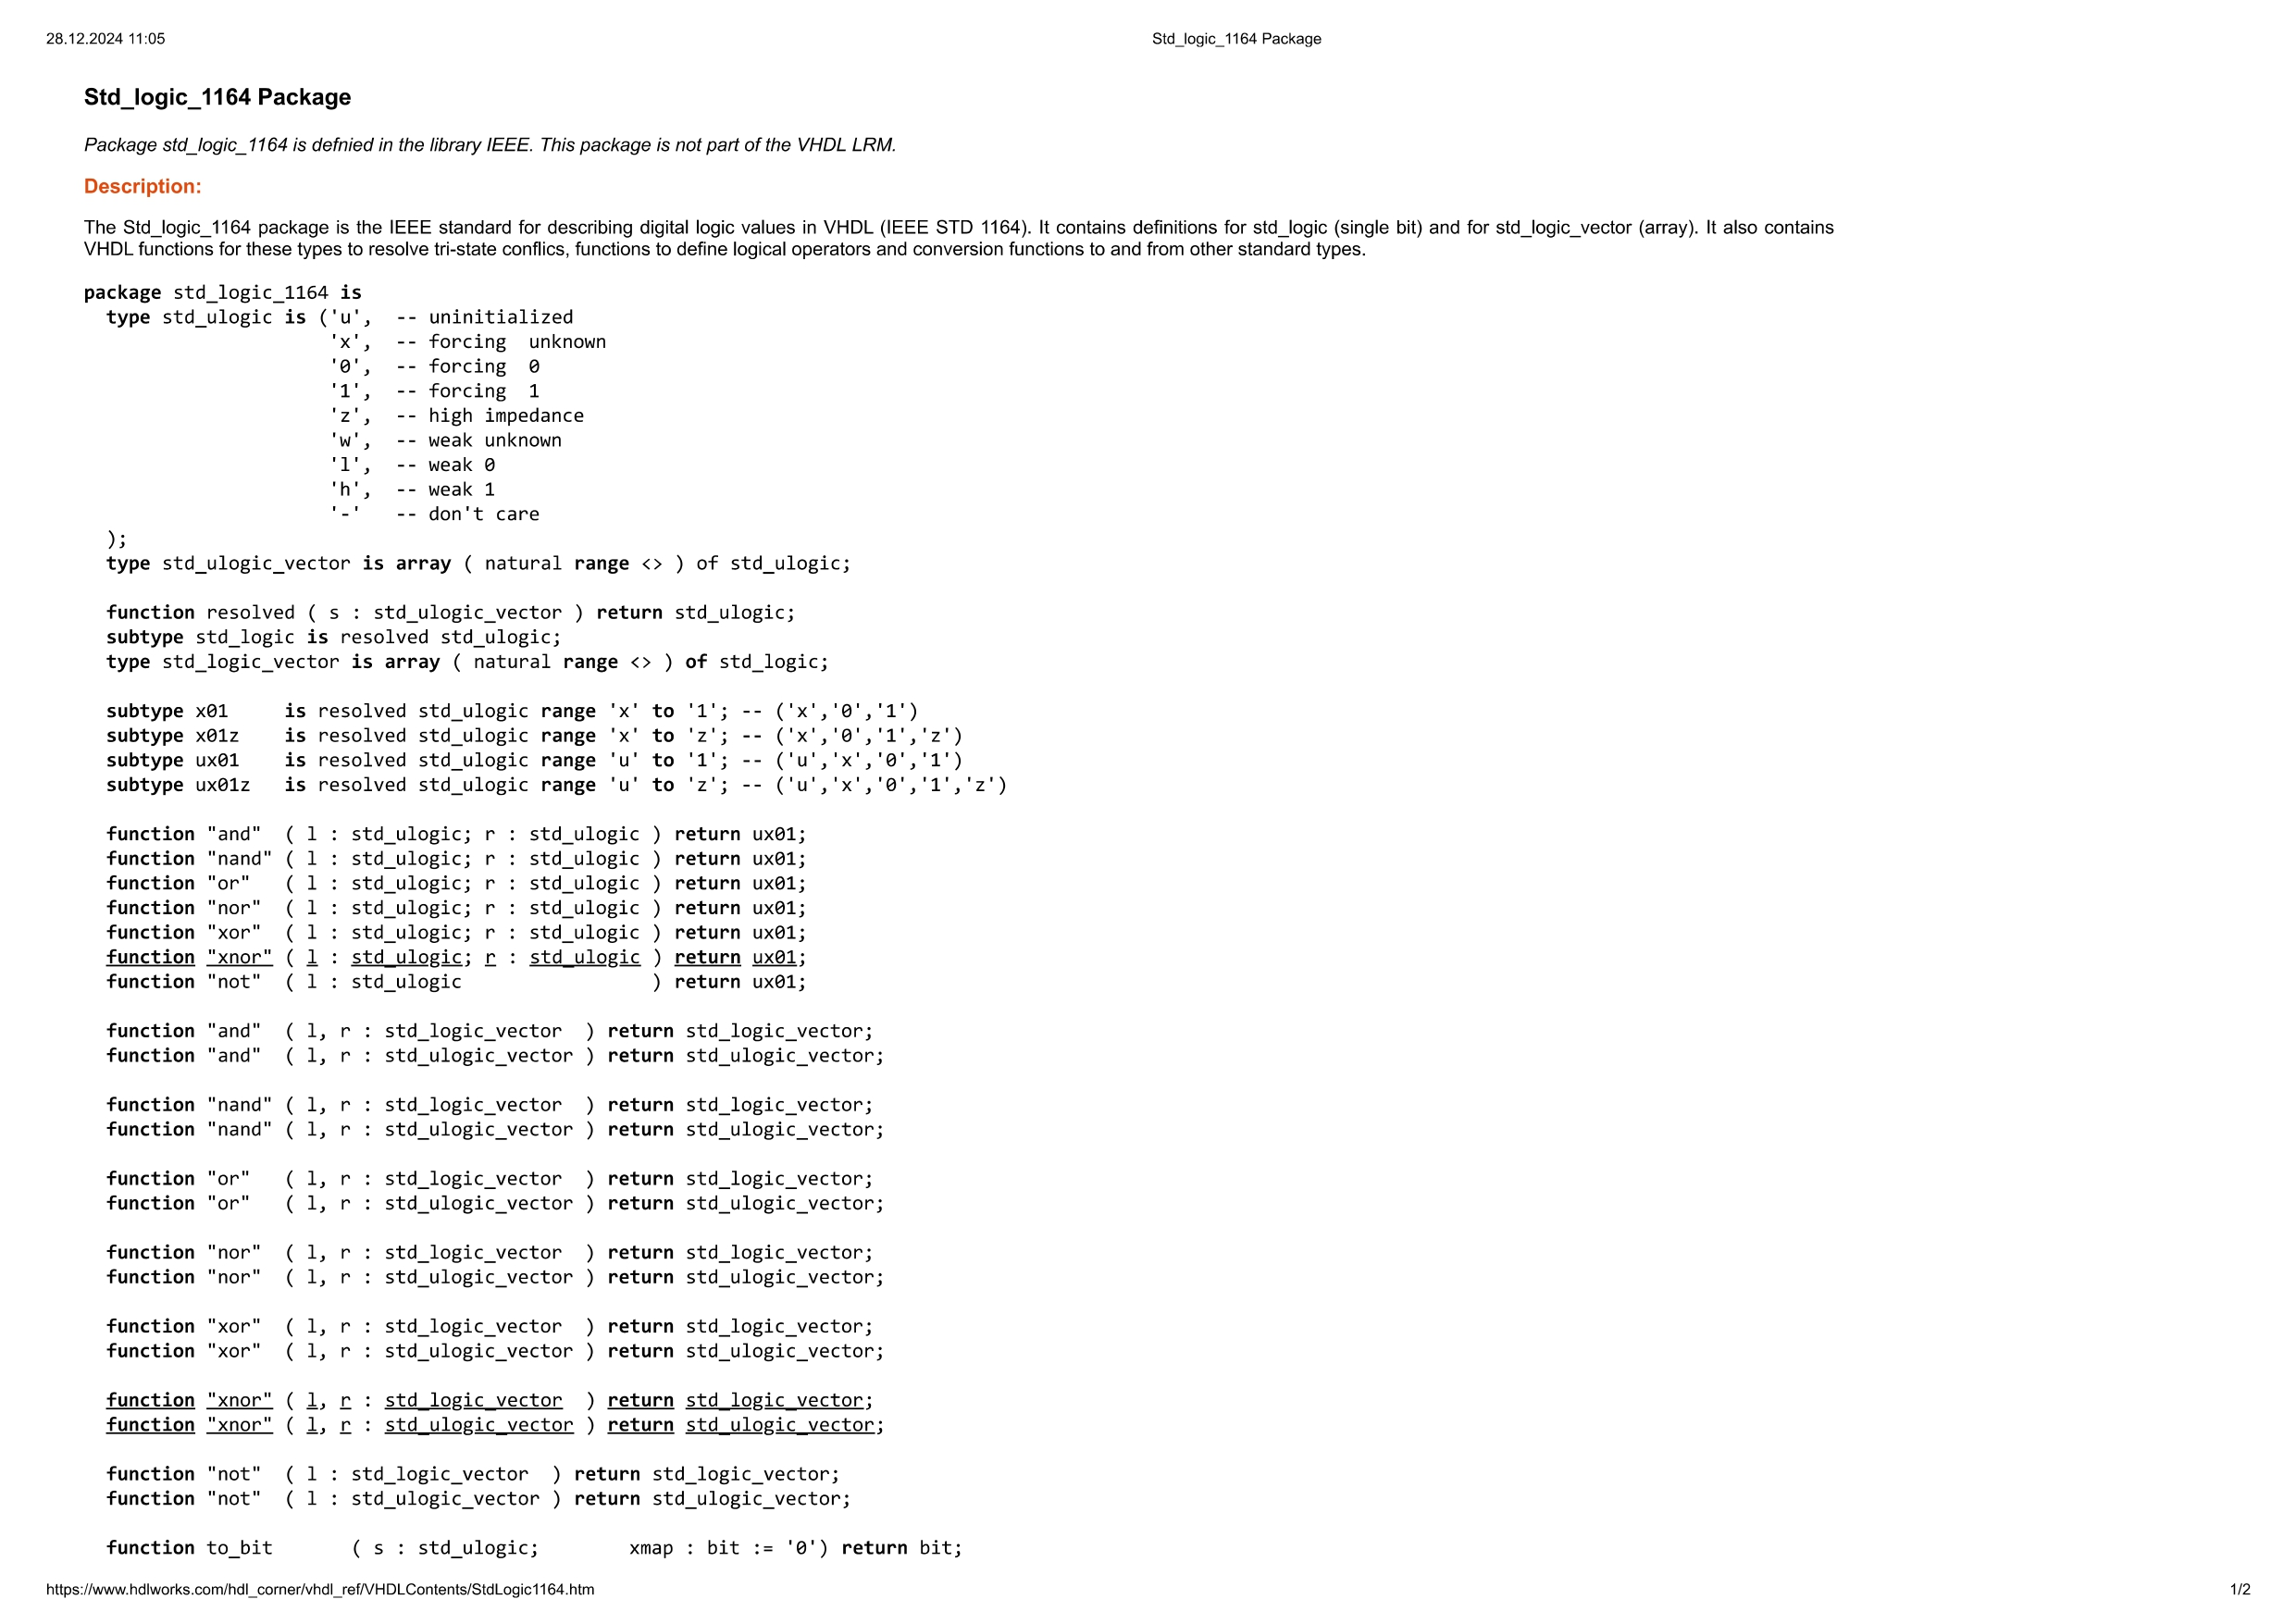
16.8 Standard Multivalue Logic Package
https://www.hdlworks.com/hdl_corner/vhdl_ref/VHDLContents/StdLogic1164.htm

Slide 90
16.9 Standard Synthesis Packages
This subclause defines standard practices for synthesizing binary digital electronic circuits from VHDL source code
a) The hardware interpretation of values belonging to the BIT and BOOLEAN types defined in package STD.STANDARD and to the STD_ULOGIC type defined in package IEEE.STD_LOGIC_1164.
b) A function (STD_MATCH) that provides “don’t care” or “wild card” testing of values based on the STD_ULOGIC type.
c) Standard functions for representing sensitivity to the edge of a signal.
d) Packages that define one-dimensional array types for representing signed and unsigned arithmetic values, and that define arithmetic, shift, and type conversion operations on those types.
function STD_MATCH (L, R: STD_ULOGIC) return BOOLEAN; function STD_MATCH (L, R: STD_LOGIC_VECTOR) return BOOLEAN;
-- Result: termwise comparison per STD_LOGIC_1164 intent -- Result: terms compared per STD_LOGIC_1164 intent

Slide 91
16.9 Standard Synthesis Context Declarations
library IEEE;
use IEEE.std_logic_1164.all;
use IEEE.numeric_std.all;
use sitelib.sitepack.all;
end context;
context proj1_context is -- compiled into library proj1lib
library sitelib;
context sitelib.site_context;
use proj1lib.proj1pack.all;
end context;
--call
library proj1lib;
context proj1lib.proj1_context;
16.10 Fixed-Point Package
The library denoted by the library logical name IEEE contains packages FIXED_FLOAT_TYPES, FIXED_GENERIC_PKG, and FIXED_PKG
16.11 Floating-Point Package
The library denoted by the library logical name IEEE contains packages FLOAT_GENERIC_PKG and FLOAT_PKG
16.12 Reflection Package
Package REFLECTION contains protected type declarations and access types to these protected types for a reflection API.

Slide 92
17. VHDL Procedural Interface overview
Chapters 17, 18 and 19
Presenter:
Furkan Kaya
18. VHPI access functions
19. VHPI information model

Slide 93
VHPI Overview
Definition: VHPI (VHDL Procedural Interface) allows interaction between external tools and the VHDL simulation environment.
Purpose:
Extend simulation functionality.
Provide dynamic access to design objects.
Key Components:
Handles: Represent simulation objects (e.g., signals, entities).
Access Functions: Perform operations on these objects.
Callbacks: Trigger actions on specific simulation events.
CODE EXAMPLE
vhpi_register_cb(vhpiCbValueChange, signal_handle, my_callback);

Slide 94
VHPI Phases
Phases of Execution:
Registration: Initialize callbacks and external tools.
Simulation: Execute the design while interacting dynamically.
Termination: Clean up and finalize external tool interactions.
CODE EXAMPLE
procedure signal_monitor is
variable value: vhpiValueT;
begin
vhpi_get_value(signal_handle, value);
report "Signal value: " & value;
end;

Slide 95
Callbacks
Purpose: Dynamically respond to events during simulation.
Types of Callbacks:
Event-based: Triggered by signal changes or processes.
Time-based: Activated after a specific time.
Phase-based: Executed at specific simulation phases.
CODE EXAMPLE
vhpi_register_cb(vhpiCbTime, 50 ns, my_callback);

Slide 96
VHPI Data Types
Definition: VHPI uses predefined data types to represent simulation data and interact with VHDL objects.
Key Data Types:
vhpiInt: Integer type for indices and counters.
vhpiReal: Real type for analog values or delays.
vhpiString: Text-based data.
vhpiValueT: Encapsulates values of signals and variables.
CODE EXAMPLE
signal_value: vhpiValueT;
vhpi_get_value(signal_handle, signal_value);

Slide 97
Data Access
Purpose: Access and manipulate data during simulation.
Methods:
Reading values using vhpi_get_value.
Writing values using vhpi_put_value.
Navigating objects using handles.
CODE EXAMPLE
signal_value.format := vhpiBinStr;
signal_value.value := "1101";
vhpi_put_value(signal_handle, signal_value, vhpiForce);

Slide 98
VHPI Object Model
Definition: Represents the hierarchical structure of VHDL designs, enabling navigation and manipulation of components.
Key Objects:
Signals: Data carriers between components.
Variables: Local storage within processes.
Processes: Describe behavior.
Components: Instances of entities.
CODE EXAMPLE
signal_handle := vhpi_handle(vhpiSignal, architecture_handle);

Slide 99
Object Hierarchy
Structure:
Designs are organized hierarchically, starting from root objects.
Parent-child relationships allow traversal between components.
Usage:
Retrieve handles for signals, processes, or variables.
Navigate design hierarchy dynamically.
CODE EXAMPLE
root_handle := vhpi_handle(vhpiRoot, null);
entity_handle := vhpi_handle_by_name("MyEntity", root_handle);

Slide 100
Signal Interaction
Purpose: Manage signal behavior during simulation.
Actions:
Monitor signal value changes.
Modify signal values dynamically to simulate specific scenarios.
CODE EXAMPLE
signal_value.value := "0000";
vhpi_put_value(signal_handle, signal_value, vhpiInertial);

Slide 101
Process and Component Interaction
Purpose: Interact with processes and components during runtime.
Actions:
Activate or deactivate processes.
Modify or monitor component behavior.
CODE EXAMPLE
process_handle := vhpi_handle(vhpiProcess, entity_handle);
vhpi_set_disable(process_handle, true);

Slide 102
Advanced Use Cases
Applications:
Debugging and monitoring signals.
Automating tests with dynamic modifications.
Interfacing with external tools for co-simulation.
CODE EXAMPLE
vhpi_register_cb(vhpiCbAfter, 100 ns, my_callback);
vhpi_get_value(signal_handle, signal_value);

Slide 103
23. Vhpı functıon reference
Chapter 23
Presenter:
Orhan Çalışkan

Slide 104
23 VHPI FUNCTION REFERENCE
int vhpi_assert(vhpiSeverityT severity, char *formatmsg, ...);
The vhpi_assert function in VHDL works like the report statement, using a format string (similar to printf) and a severity argument to generate a formatted message with a severity level
int vhpi_check_error (vhpiErrorInfoT *error_info_p);
The vhpi_check_error function checks if the previous VHPI function call raised an error. It takes an argument, error_info_p, which is either a pointer to an error information structure or NULL.
int vhpi_compare_handles (vhpiHandleT handle1, vhpiHandleT handle2);
Determines whether the arguments handle1 and handle2 refer to the same object
1 if handle1 and handle2 refer to the same object, or 0 otherwise

Slide 105
23 VHPI FUNCTION REFERENCE
int vhpi_control (vhpiSimControlT command, ...);
The vhpi_control function requests specific control actions for a VHPI tool
vhpiStop: Stops the simulation and waits for further commands
vhpiFinish: Enters the termination phase of the simulation
vhpiReset: Enters the reset phase of the simulation
If the command is not one of these, the tool performs a custom action
vhpiHandleT vhpi_create (vhpiClassKindT kind, vhpiHandleT handle1,
vhpiHandleT handle2);
The vhpi_create function is used to create VHPI objects of specific classes, such as processStmt or driver, based on the kind argument
It associates the created objects with other VHPI objects and sets certain properties (like IsForeign) to default values

Slide 106
23 VHPI FUNCTION REFERENCE
vhpiIntT vhpi_get(vhpiIntPropertyT property, vhpiHandleT object);
The function disables an enabled callback, preventing the callback function from executing when the trigger event occurs
It returns the property value if readable, or vhpiUndefined if the property cannot be read
size_t vhpi_get_data(int32_t id, void * dataLoc, size_t numBytes);
The vhpi_get_data function reads a specified number of bytes from a saved data set and writes them to dataLoc
It continues reading from the last location on subsequent calls and writes zeros if fewer bytes remain than requested
int vhpi_get_foreignf_info (vhpiHandleT hdl, vhpiForeignDataT *foreignDatap);
The vhpi_get_foreignf_info function retrieves details about a foreign model or application, such as its type, functions, and names, and stores them in the foreignDatap structure. It returns 0 on success or 1 on error

Slide 107
23 VHPI FUNCTION REFERENCE
int vhpi_get_next_time (vhpiTimeT *time_p);
The vhpi_get_next_time function writes the time of the next simulation cycle (Tn) to a provided time structure. It returns vhpiNoActivity if no further simulation activity exists, 0 if successful, or a non-zero value on error
vhpiPhysT vhpi_get_phys (vhpiPhysPropertyT property, vhpiHandleT object);
The vhpi_get_physical_property function retrieves the value of a specified physical property for a given object. It returns the property value if readable or an unspecified value otherwise
vhpiRealT vhpi_get_real (vhpiRealPropertyT property, vhpiHandleT object);
The vhpi_get_real_property function retrieves the value of a specified real property for a given object. It returns the property value if readable or an unspecified value otherwise

Slide 108
23 VHPI FUNCTION REFERENCE
const vhpiCharT * vhpi_get_str (vhpiStrPropertyT property, vhpiHandleT object);
The vhpi_get_str_property function retrieves the value of a specified string property for a given object. It returns a pointer to the string if readable or NULL otherwise
void vhpi_get_time (vhpiTimeT *time_p, long *cycles);
The vhpi_get_time function retrieves the current simulation time and/or the number of delta or total simulation cycles. It writes these values to provided pointers and returns no value
int vhpi_get_value (vhpiHandleT expr, vhpiValueT *value_p);
The vhpi_get_value function formats and retrieves the value of the object referred to by expr. It returns 0 on success, required storage size if space is insufficient, or a negative value on error

Slide 109
23 VHPI FUNCTION REFERENCE
vhpiHandleT vhpi_handle (vhpiOneToOneT type, vhpiHandleT referenceHandle);
The vhpi_handle function retrieves the target object of a one-to-one association based on type and referenceHandle. It returns a handle to the target object if one exists or NULL otherwise
vhpiHandleT vhpi_handle_by_index (vhpiOneToManyT itRel, vhpiHandleT parent, int32_t indx);
The vhpi_handle_by_index function retrieves a target object from an ordered one-to-many association using itRel, parent, and indx. It returns a handle to the target object at the specified index or NULL if no such object exists
vhpiHandleT vhpi_handle_by_name (const char *name, vhpiHandleT scope);
The vhpi_handle_by_name function searches for an object by its FullName using the name string and optional scope. It returns a handle to the found object or NULL if not found

Slide 110
23 VHPI FUNCTION REFERENCE
int vhpi_is_printable( char ch )
The function checks if the character code of the ch argument represents a graphic character. Return 1 if it's a graphic character, 0 otherwise
vhpiHandleT vhpi_iterator (vhpiOneToManyT type, vhpiHandleT referenceHandle);
The function creates an iterator object for a one-to-many association if target objects exist and returns a handle to the iterator. If no target objects exist, it returns NULL
int vhpi_printf (const char *format, ...);
The function writes a formatted string to one or more tool output files based on a format string and arguments, similar to the C printf function. It returns the number of characters written, or -1 if an error occurs

Slide 111
23 VHPI FUNCTION REFERENCE
int vhpi_protected_call (vhpiHandleT varHdl, vhpiUserFctT userFct, void *userData);
The vhpi_protected_call function ensures exclusive access to a varDecl object with specific properties and calls the user function with the object handle and user data. It returns the value from the user function
size_t vhpi_put_data (int32_t id, void * dataLoc, size_t numBytes);
The vhpi_put_data function writes bytes from dataLoc to the saved data set identified by id. It returns the number of bytes written, or 0 if the write fails,
int vhpi_put_value (vhpiHandleT object, vhpiValueT *value_p, vhpiPutValueModeT mode);
The object argument is a handle to an object or function with a foreign subprogram. The value_p specifies the value to update, and mode determines the update method. The function returns 0 if successful, or a non-zero value if there's an error.

Slide 112
23 VHPI FUNCTION REFERENCE
vhpiHandleT vhpi_register_cb (vhpiCbDataT *cb_data_p, int32_t flags);
The cb_data_p argument is a pointer to the callback data, and flags specify the registration mode. The function registers a callback and returns a handle if vhpiReturnCb is set, or NULL if cleared. If vhpiDisableCb is set, the callback is disabled; otherwise, it's enabled. The function does not retain references after execution
vhpiHandleT vhpi_register_foreignf (vhpiForeignDataT *foreignDatap);
The foreignDatap argument is a pointer to a foreign data structure for registration, specifying the foreign entity type with kind and including function pointers for elaboration (elabf) and execution (execf). It also includes libraryName and modelName for the object and model names. The function registers the foreign entity and returns a handle if successful, or NULL on Error
int vhpi_release_handle (vhpiHandleT object);
The object argument is a handle referring to an object. The function releases the handle and returns 0 if successful, or 1 if an error occurs

Slide 113
23 VHPI FUNCTION REFERENCE
int vhpi_remove_cb (vhpiHandleT cb_obj);
The cb_obj argument is a handle to a registered callback. The function removes the callback, invalidating the handle. It returns 0 if successful, or 1 if an error occurs
vhpiHandleT vhpi_scan (vhpiHandleT iterator);
The iterator argument is a handle to an iterator object. If the iterator has no element at its position, the handle is released and NULL is returned. Otherwise, a handle to the current element is returned, and the iterator moves to the next element. The return value is either a handle or NULL

Slide 114
23 VHPI FUNCTION REFERENCE
int vhpi_schedule_transaction (vhpiHandleT drivHdl, vhpiValueT *value_p,uint32_t numValues, vhpiTimeT *delayp, vhpiDelayModeT delayMode, vhpiTimeT *pulseRejp);
drivHdl refers to a driver or driverCollection. value_p is a pointer to value structures, and numValues is the count. Transactions are scheduled with a relative delay (delayp), and delayMode specifies the type (inertial or transport)
If delayMode is inertial, pulseRejp sets the pulse rejection limit; otherwise, it's ignored. If pulseRejp is NULL, the limit equals the delay
Return 0 if successful, non-zero if error occurs
int vhpi_vprintf (const char *format, va_list args);
The format argument is a pointer to a format string with conversion codes, as per ISO/IEC 9899:2018 for the C vprintf function. It formats a string to be written to output files
Return value: The number of characters written, or -1 if an error occurs

Slide 115
24. STANDARD TOOL DIRECTIVES
Chapter 24
Presenter:
Seyit Koçak
24.1 Protect Tool Directives
24.2 Conditional Analysis Tool Directives

Slide 116
24.1 PROTECT TOOL DIRECTIVES
Encrypt VHDL designs to prevent text disclosure while allowing authorized tools to process the design
Key Elements:
Encryption Envelope: Encrypted text and instructions
Decryption Envelope: Details for decryption
24.2 CONDITIONAL ANALYSIS TOOL DIRECTIVES
Purpose: Allows conditional inclusion/exclusion of VHDL description parts based on tool or user settings
Key Elements:
Warning: Adds a warning message, does not stop analysis
Error: Stops analysis with an error message
Tool-Supplied Identifiers:
VHDL_VERSION: VHDL version (e.g., "2008")
TOOL_TYPE: Tool type (e.g., "SIMULATION")
TOOL_NAME/EDITION/VERSION: Tool-specific details
.

Slide 117
End of IEEE 1076 – 2002 Standard
VHDL Project Closure Presentation
THANKS
Furkan Kaya,
Mert Ecevit,
Orhan Çalışkan,
Seyit Koçak
Yunus Küçük
www.youtube.com/@falsepaths

